Slide 1
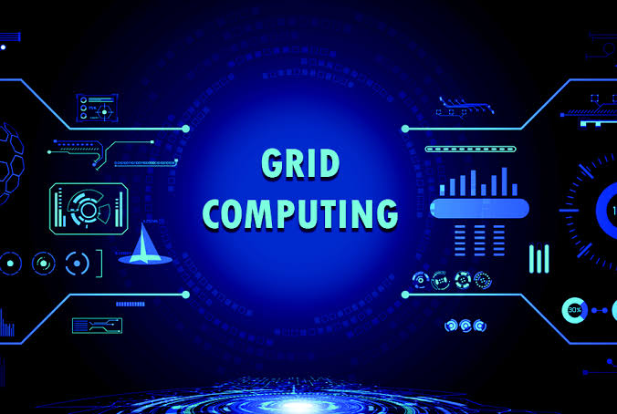

Slide 2
Grid Computing
Grid Computing can be defined as a network of computers working together to perform a task that would rather be difficult for a single machine.
All machines on that network work under the same protocol to act as a virtual supercomputer.
The task that they work on may include analyzing huge datasets or simulating situations that require high computing power.
Computers on the network contribute resources like processing power and storage capacity to the network.

Slide 3
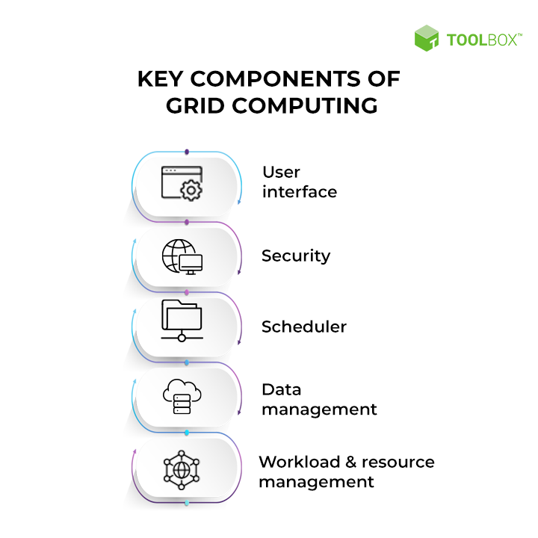
Key Components of Grid Computing

Slide 4
Key Components of Grid Computing
1. User interface :
Today, users are well-versed with web portals.They provide a single interface that allows users to view a wide variety of information.
Similarly, a grid portal offers an interface that enables users to launch applications with resources provided by the grid.
2. Security :
Security is one of the major concerns for grid computing environments. Security mechanisms can include authentication, authorization, data encryption, and others.
3. Scheduler :
When you want to run specific tasks concurrently that require inter-process communication, the job scheduler would suffice to coordinate the execution of different subtasks.

Slide 5
Key Components of Grid Computing
4. Data management :
Data management is crucial for grid environments. A secure and reliable mechanism to move or make any data or application module accessible to various nodes within the grid is necessary.
Consider the Globus toolkit — an open-source toolkit for grid computing.
5. Workload & resource management :
The workload & resource component enables the actual launch of a job on a particular resource, checks its status, and retrieves the results when the job is complete.
Say a user wants to execute an application on the grid. In that case, the application should be aware of the available resources on the grid to take up the workload.

Slide 6
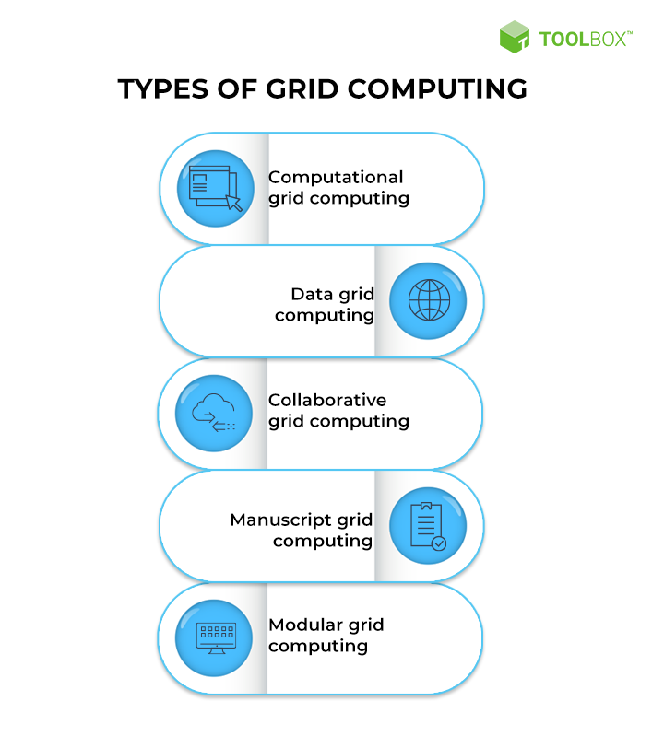

Slide 7
Advantages of Grid Computing
It is not centralized, as there are no servers required, except the control node which is just used for controlling and not for processing.
Multiple heterogeneous machines i.e. machines with different Operating Systems can use a single grid computing network.
Tasks can be performed parallelly across various physical locations and the users don’t have to pay for them (with money).

Slide 8
Disadvantages of Grid Computing
The software of the grid is still in the involution stage.
A super fast interconnect between computer resources is the need of hour.
Licensing across many servers may make it prohibitive for some applications.
Many groups are reluctant with sharing resources .

Slide 9
GRID COMPUTING MACHINE
A Grid computing network mainly consists of these three types of machines.
1.Control Node:
A computer, usually a server or a group of servers which administrates the whole network and keeps the account of the resources in the network pool.
2. Provider:
The computer contributes its resources to the network resource pool.
3.User:
The computer that uses the resources on the network.

Slide 10
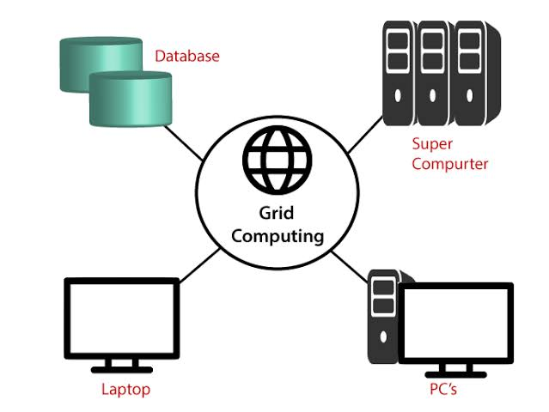

Slide 11
WORKING
When a computer makes a request for resources to the control node, the control node gives the user access to the resources available on the network.
When it is not in use it should ideally contribute its resources to the network.
Hence a normal computer on the node can swing in between being a user or a provider based on its needs.
The nodes may consist of machines with similar platforms using the same OS called homogeneous networks, else machines with different platforms running on various different OSs called heterogeneous networks.
This is the distinguishing part of grid computing from other distributed computing architectures.
For controlling the network and its resources a software/networking protocol is used generally known as Middleware.
This is responsible for administrating the network and the control nodes are merely its executors.
As a grid computing system should use only unused resources of a computer, it is the job of the control node that any provider is not overloaded with tasks.

Slide 12
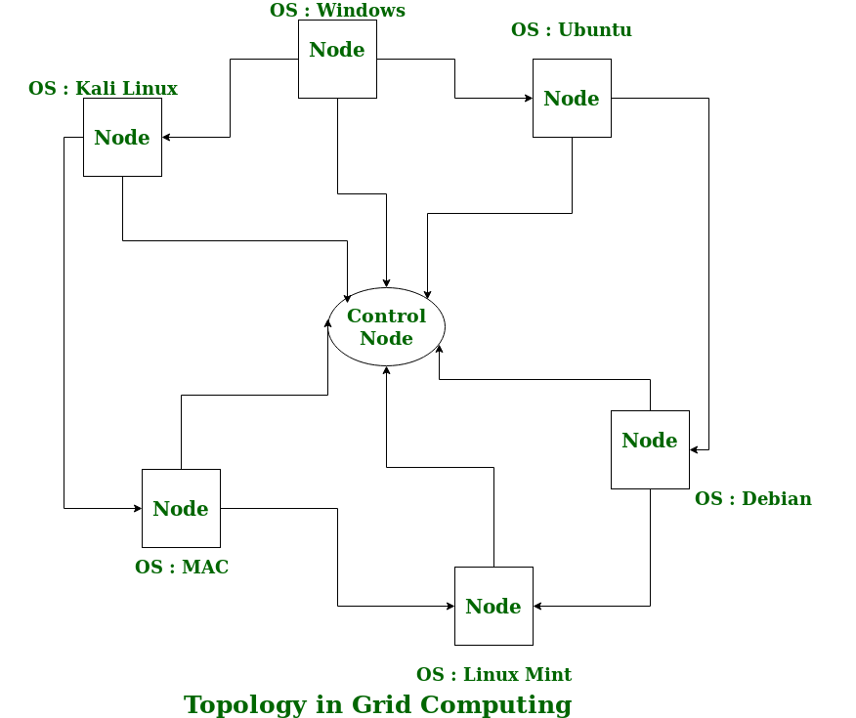

Slide 13
The meaning of the term Grid Computing has changed over the years, according to “The Grid: Blueprint for a new computing infrastructure” by Ian Foster and Carl Kesselman published in 1999, the idea was to consume computing power like electricity is consumed from a power grid.
This idea is similar to the current concept of cloud computing, whereas now grid computing is viewed as a distributed collaborative network.
Currently, grid computing is being used in various institutions to solve a lot of mathematical, analytical, and physics problems.

Slide 14
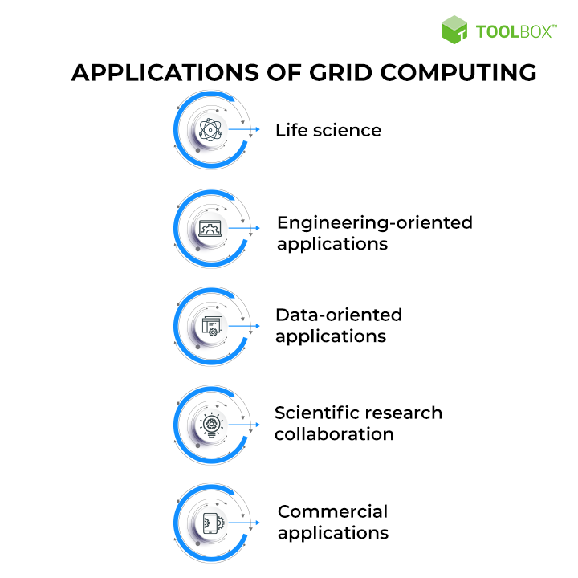

Slide 15


